Slide 1






JedAI: The Force behind Entity Resolution
George Papadakis
Leonidas Tsekouras
Emmanouil Thanos
George Giannakopoulos
Themis Palpanas
Manolis Koubarakis

Slide 2
What is JedAI Toolkit?
JedAI can be used in three ways:
As an open source library that implements numerous state-of-the-art methods for all steps of an established end-to-end ER workflow.
As a desktop application for ER with an intuitive Graphical User Interface that is suitable for both expert and lay users.
As a workbench for comparing all performance aspects of various (configurations of) end-to-end ER workflows.

Slide 3
How does JedAI Toolkit work?
JedAI implements the following schema-agnostic, end-to-end workflow for both Clean-Clean and Dirty ER:
Step 1
Step 2
Step 3
Step 4
Step 5
Step 6
Step 7
Data Reading
Block
Building
Block
Cleaning
Comparison
Cleaning
Entity
Matching
Entity
Clustering
Evaluation & Storing
Reads files containing the entity profiles and the golden standard.
Creates
overlapping blocks.
Optional step that cleans blocks from useless comparisons (repeated, superfluous).
Optional step that operates on the level of individual comparisons to remove the useless ones.
Executes all retained comparisons.
Partitions the similarity graph into equivalence clusters.
Stores and presents performance results w.r.t. numerous measures.

Slide 4
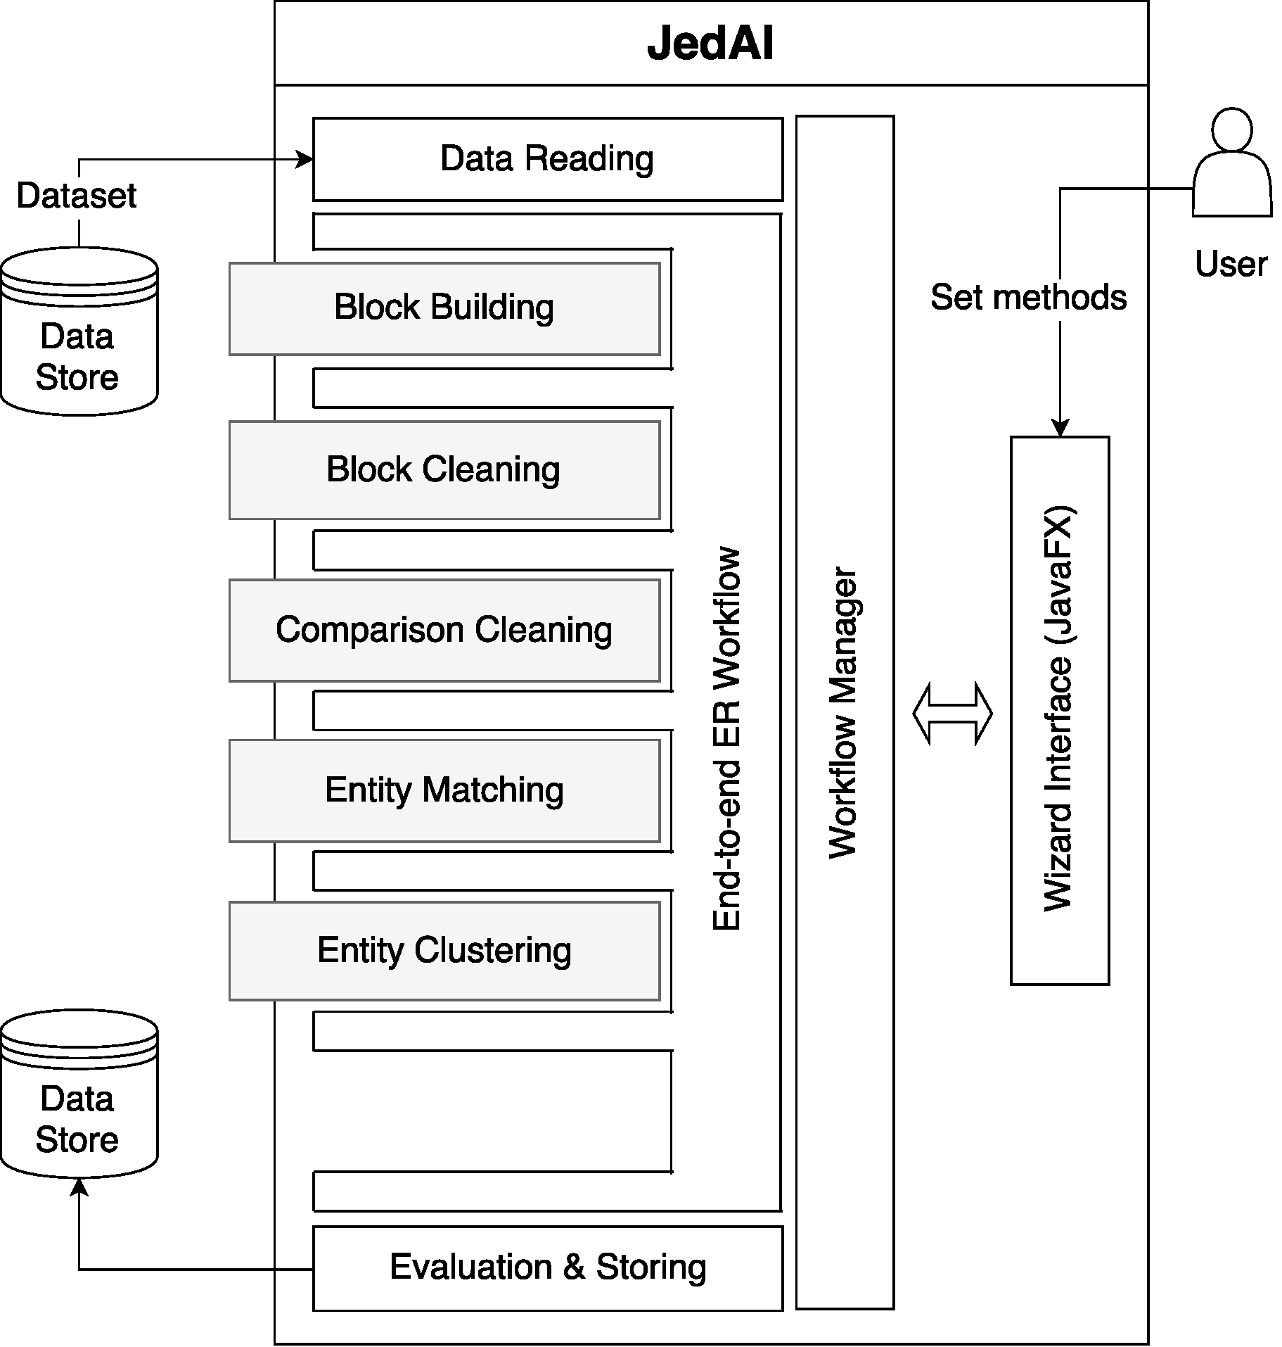
How is JedAI Toolkit built?
Modular architecture: one module per workflow step.
Extensible architecture (e.g., ontology matching)
???

Slide 5
How can I build an ER workflow?
JedAI supports several established methods for each workflow step:
Step 1
Step 2
Step 3
Step 4
Step 5
Step 6
Step 7
Data Reading
Block
Building
Block
Cleaning
Comparison
Cleaning
Entity
Matching
Entity
Clustering
Evaluation & Storing
Possible to read CSV, RDF/XML files & relational DBs in any combination!
Choose 1 out of 8 methods.
Specify any combination of 3 (4) complementary methods for Dirty (Clean-Clean) ER.
Choose 1 out of 7 methods (including Meta-blocking).
Combine 1 out of 2
methods with 12 textual representation models and 10 similarity measures.
Choose 1 out of 6 methods for Dirty ER. For Clean-Clean ER, 1 method is available.
Store results as a CSV file.

Slide 6
Where can I find JedAI Toolkit?
Project website: http://jedai.scify.org .
Github repository of JedAI Library: https://github.com/scify/JedAIToolkit .
Github repository of JedAI Desktop Application and Workbench: https://github.com/scify/jedai-ui .
All code is implemented using Java 8.
All code is available under Apache License V2.0.
All code is well documented.
Several datasets are available for testing at https://github.com/scify/JedAIToolkit .

Slide 7
What are the next steps?
Version 2.0:
Includes support for SPARQL endpoints, multicore functionality and configuration optimization.
Available at the end of September, 2017.
Version 3.0:
Includes support for ontology matching, progressive ER as well as a workflow builder.
Available at the end of December, 2017.
Version 4.0:
All functionality is implemented in Apache Spark.
Available at the end of December, 2018.

